Slide 2

Project 3: Law-based and document-based chatbot
Trieu Kinh Quoc | 20225524

Slide 3
Table of contents
1. Topic
2. Framework and Tools
3. Completed progress
4. Upcoming Work

Slide 4
1. Topic
Purpose:
- Propose the use of vector database (RAG) and LLM system for helping answer user queries.
- Two specific tasks:
Answer user’s query based on references laws.
Answer user’s query based on a document.
- Build the interactive interface that user can communicate with the chatbot.
- Final output: Simulate multi-agent AI for improving the accuracy of answers.

Slide 5
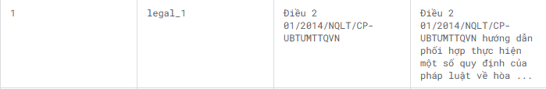
2. Framework and Tools:
2.1. Proposed framework:
- RAG: Faiss
- LLM: HuggingFace + Langchain
- UI: Streamlit
2.2. Data source:
- Vietnamese Laws: Vietnam Legal Dataset - kaggle
- Contains 700000 laws, each includes:
Id: id of the laws
Title: name of the laws
Context: Content of the laws
Example of 1 sample

Slide 6
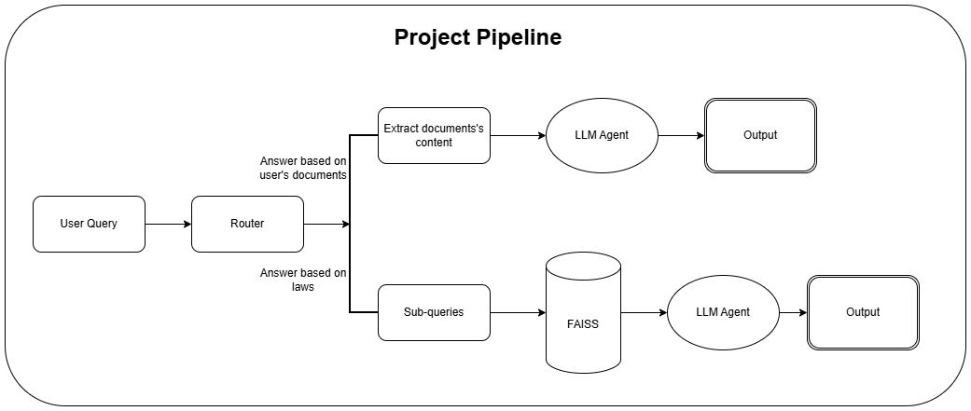
2. Framework and Tools:

Slide 7
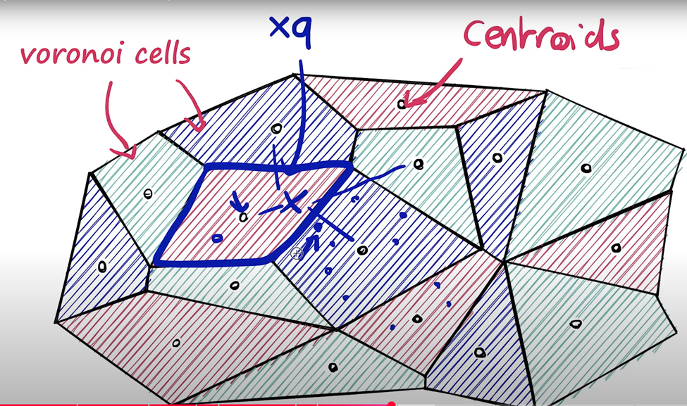
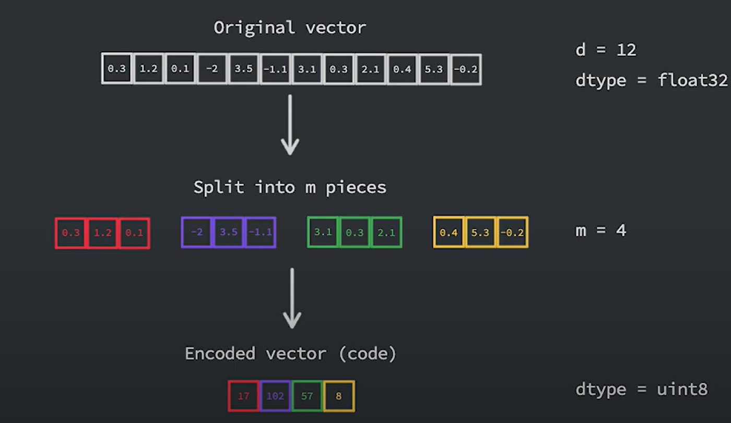
3. Completed Progress
3.1. RAG Implementation:
- Implement IVF+PQ: a combination of vector quantization and vector partition techniques for optimizing queries’ search time but still ensure the efficient.
IVF Technique
Source: Youtube: Similarity Search and Faiss Course
Product Quantization
Source: Medium

Slide 8
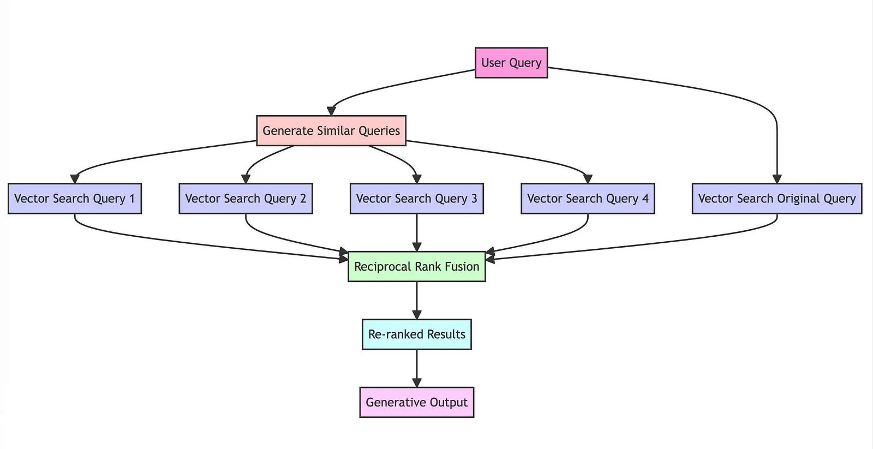

3. Completed Progress
3.1. RAG Implementation:
- Implement Reciprocal Ranking Fusion: a fusion technique that combines ranking results from multiple retrievers to improve the accuracy of query results
Source: Viblo

Slide 9
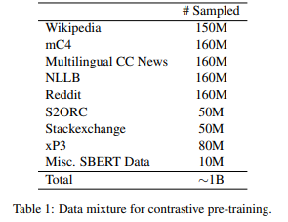
3. Completed Progress
3.1. RAG Implementation:
- Embedding model: huggingface.co/intfloat/multilingual-e5-large
- Reason used: With 1014-dimensional embeddings, it provides high-quality, multilingual sentence embeddings that capture semantic similarity across many languages, especially in Vietnamese. E5-large embedding is also trained from different sources which makes it a high capability for future expansion.
Data source to train e5-large
Source: Multilingual E5 Text Embeddings: A Technical Report

Slide 10
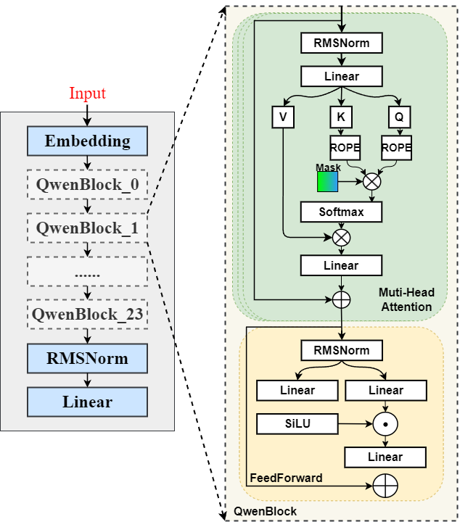
3. Completed Progress
3.2. LLM:
- Proposed model: https://huggingface.co/Qwen/Qwen2.5-1.5B
- An open-source QWEN large language model containing 1.5 billions parameters.
- Reason used: efficient for chatbot implementation and support Vietnamese.

Slide 11
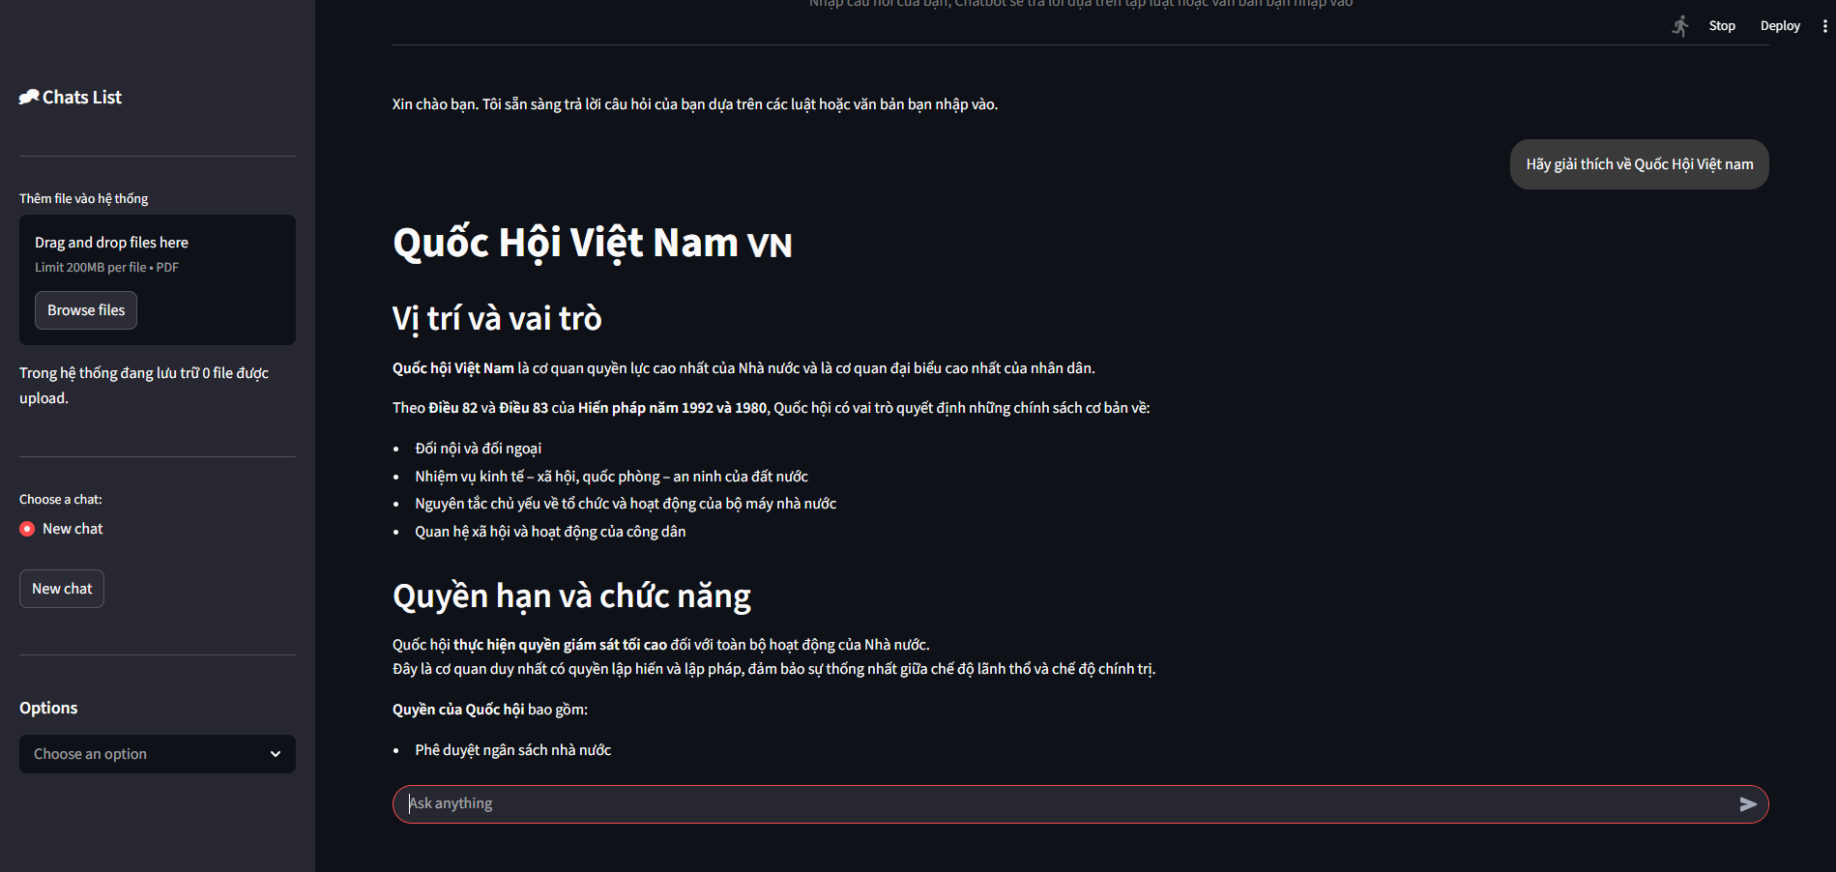
3. Completed Progress
3.3. UI by Streamlit:
- Make a new chat
- Rename a chat
- Delete a chat
- Option: Upload pdf documents for chatbot to answer

Slide 12
4. Upcoming Work
- Fine Tune the LLM with Q&A dataset
- Transform to a multi-agent system:
Router Agent: define the types of queries.
Law Agent: answer users queries based on references laws.
Document Agent: answer users queries based on documents.
Verifier Agent: verifies outputs of others agent to give the final answer.
=> Try to fine-tune. If not, find the suitable fine-tuned Adapters in HuggingFace.

Slide 13
THANK YOU !

